Slide 1
乐观估计
许志钦
上海交通大学
2025年10月5日星期日

Slide 2
传统的最差估计

Slide 3
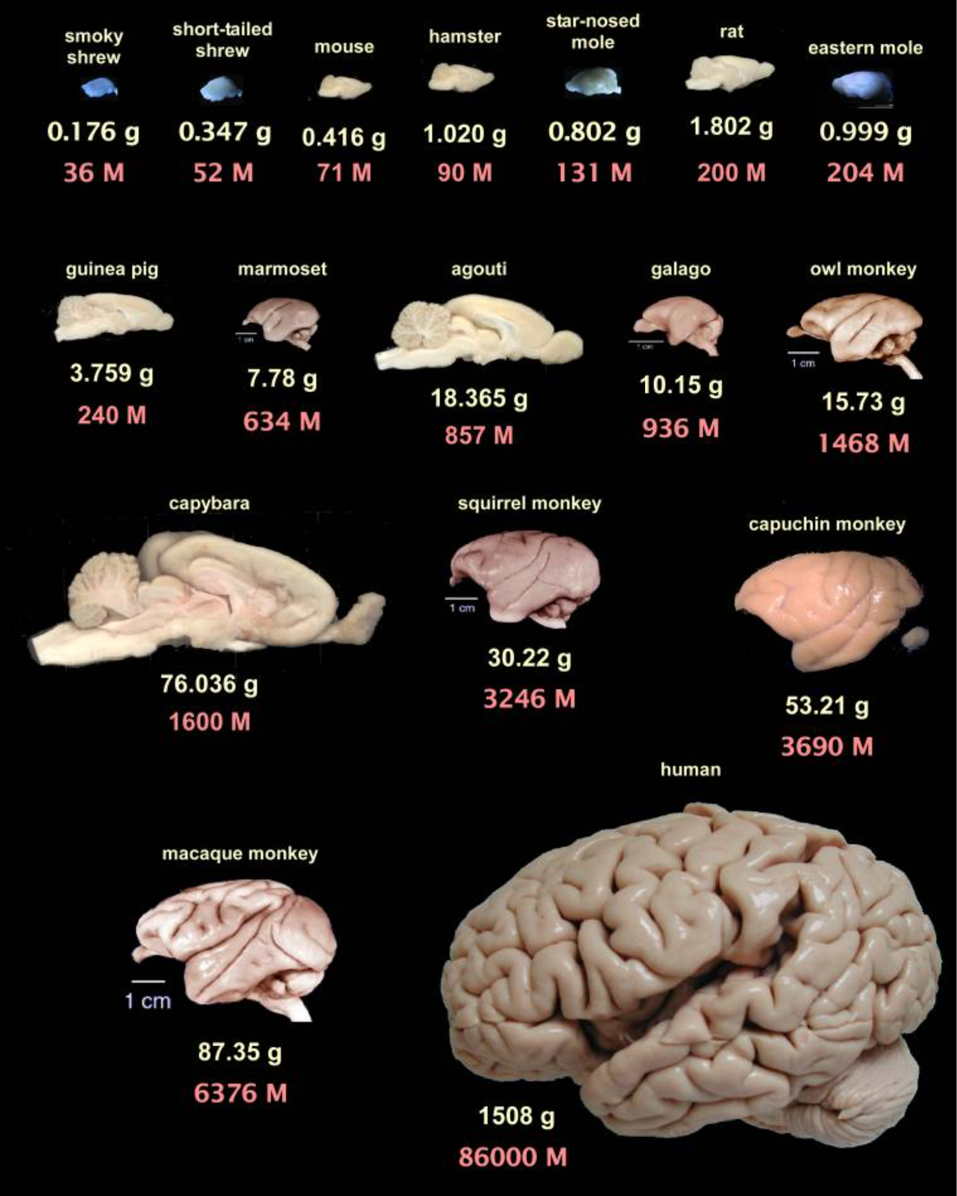
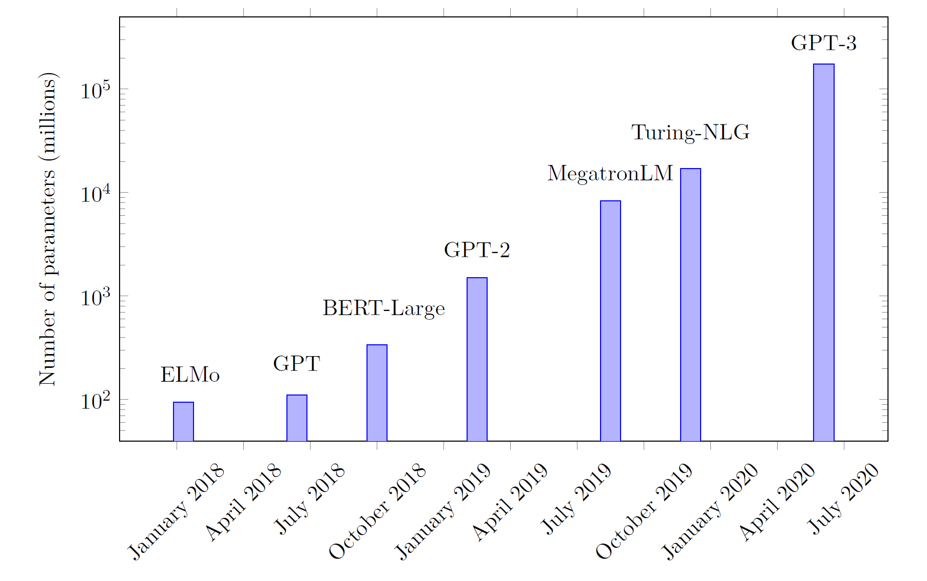
神经网络越来越大
Guillaume Hocquet. Class Incremental Continual Learning in Deep Neural Networks. Université Paris-Saclay, 2021
Suzana Herculano-Houzel, 2009

Slide 4
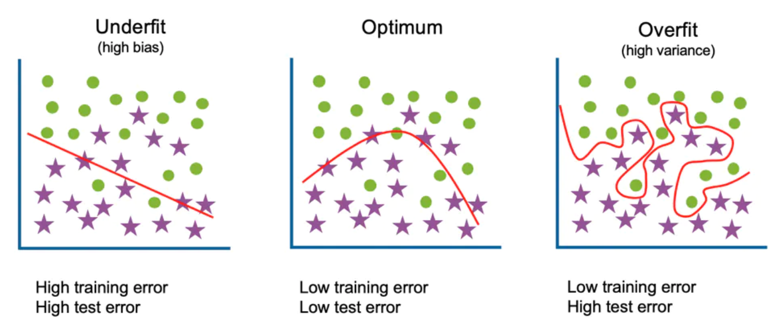
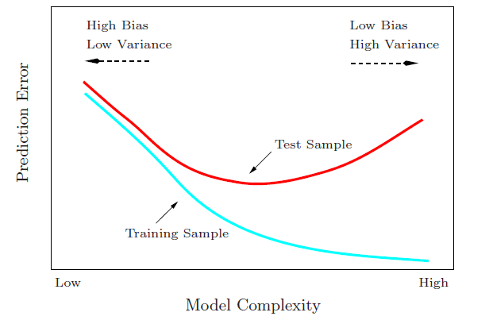
Start from traditional generalization gap
Large complexity → Large generalization gap
Generalization Gap
Traditional wisdom: Too complex is trouble

Slide 5
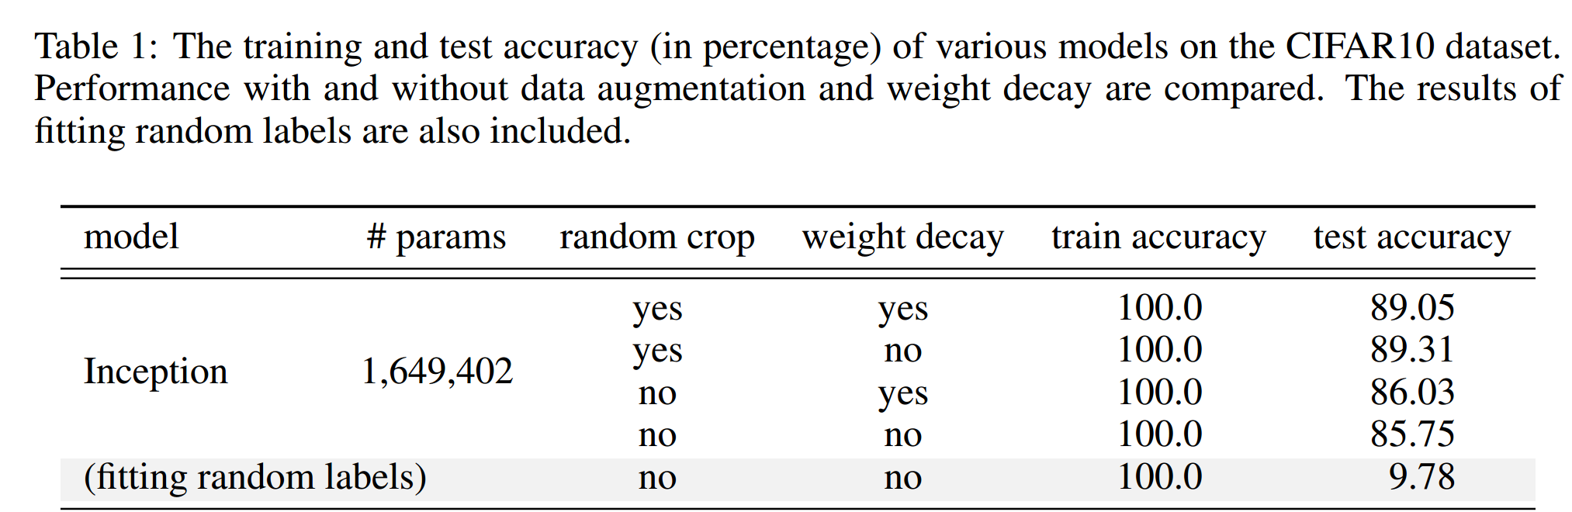
A generalization puzzle arises in deep learning
Puzzle: generalize well even # of para >> # of training data
60000 32x32 colour images in 10 classes
This trouble ignores deep learning?
L. Breiman 1995, Zhang et al., 2016

Slide 6

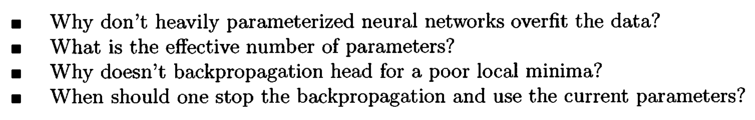
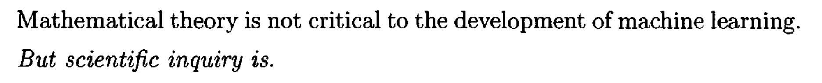
Long-standing problems
1995

Slide 7
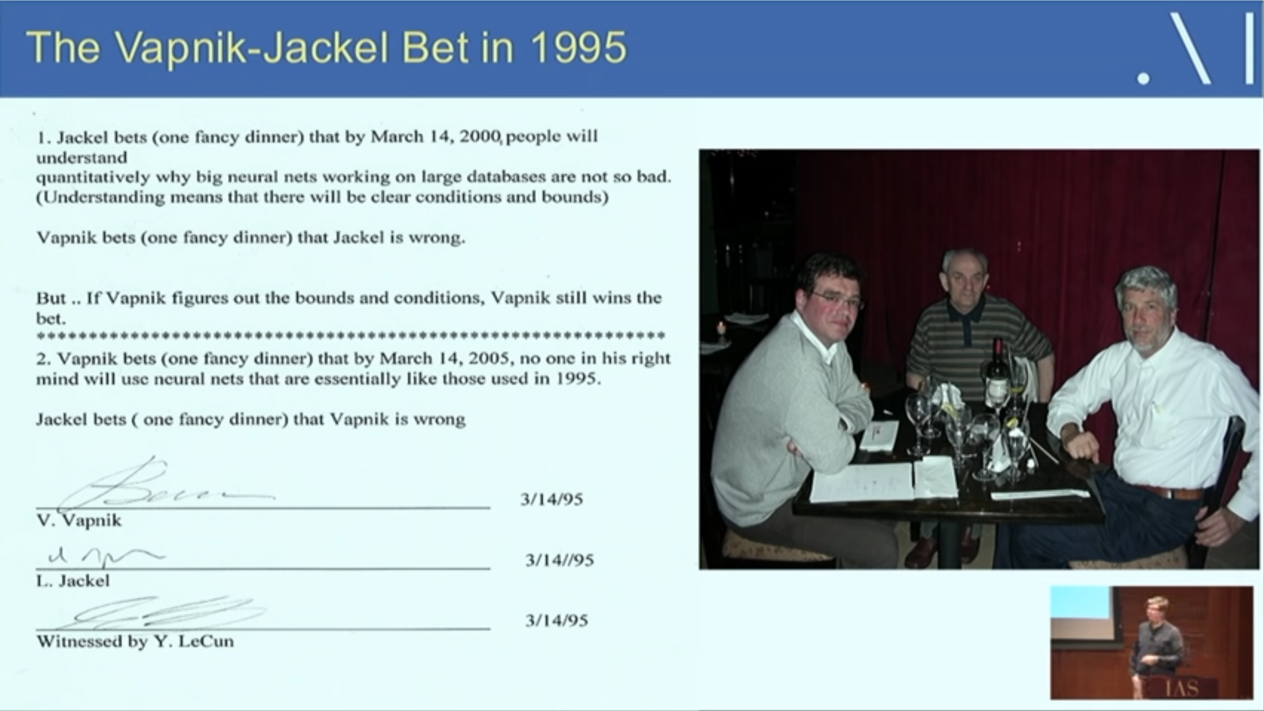
The “cloud” obscures deep learning
From LeCun’s talk

Slide 8
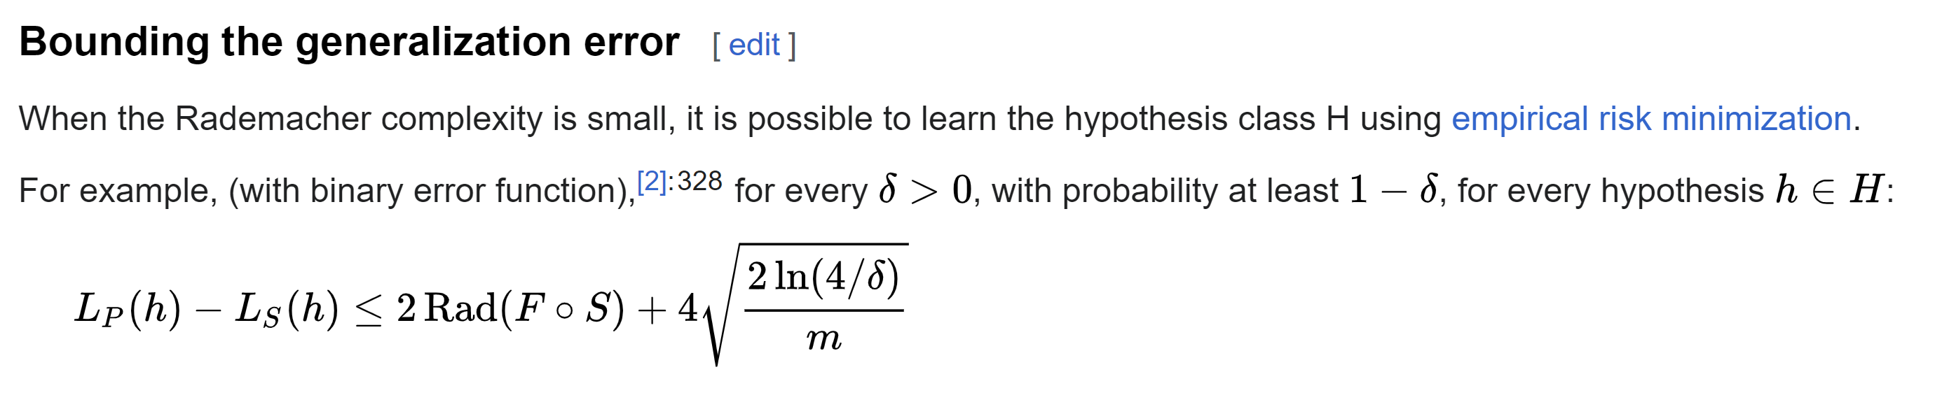
Rademacher complexity
Worst case estimation

Slide 9
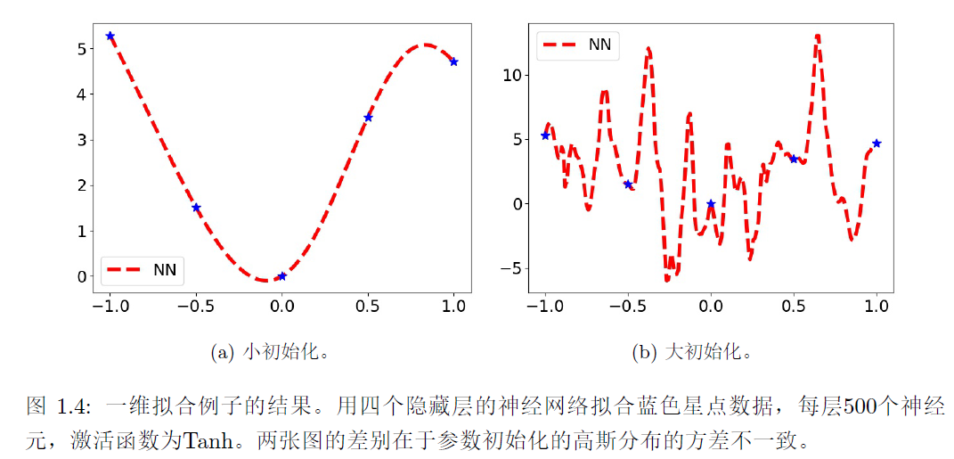
A same model can be good or be bad
Bad case

Slide 10
It is right! But not useful in practice!

Slide 11
实验启发的乐观估计

Slide 12
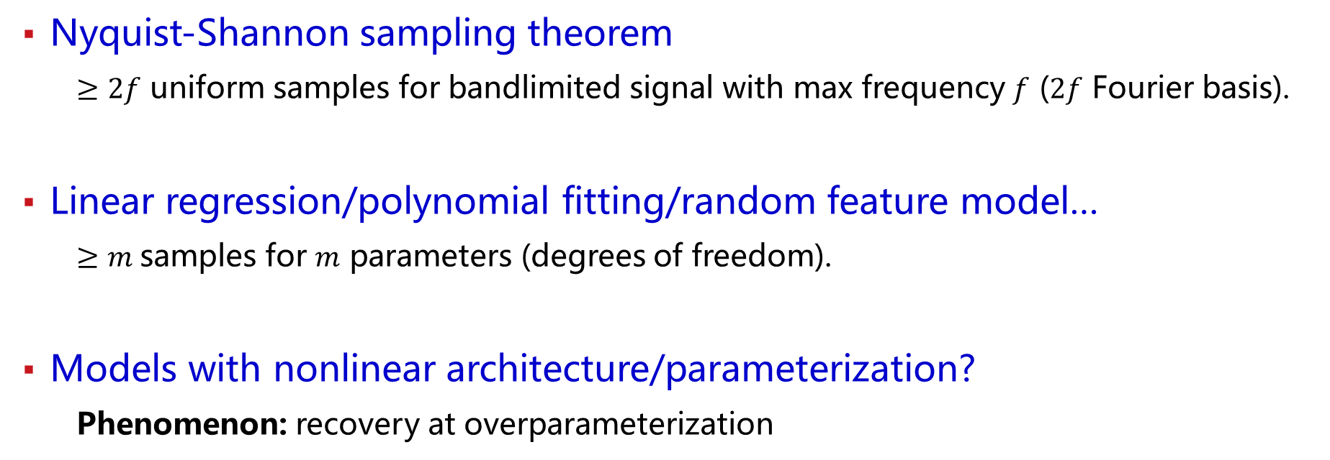
Old problem: sample size for exact recovery
For a model with M parameters, how many samples is needed?
Traditionally, Worst case estimation: M
Nyquist-Shannon sampling theorem
$≥2f$ uniform samples for bandlimited signal with max frequency $f$ ($2f$ Fourier basis).
Linear regression/polynomial fitting/random feature model…
$≥m$samples for $m$ parameters (degrees of freedom).
Models with nonlinear architecture/parameterization?
Phenomenon: recovery at overparameterization

Slide 13
A generalization puzzle arises in deep learning
Puzzle: generalize well even # of para >> # of training data
60000 32x32 colour images in 10 classes
Zhang et al., 2016

Slide 14
A generalization puzzle arises in deep learning
Puzzle: generalize well even # of para >> # of training data
Really so many effective neurons in large networks?
60000 32x32 colour images in 10 classes
Zhang et al., 2016

Slide 15
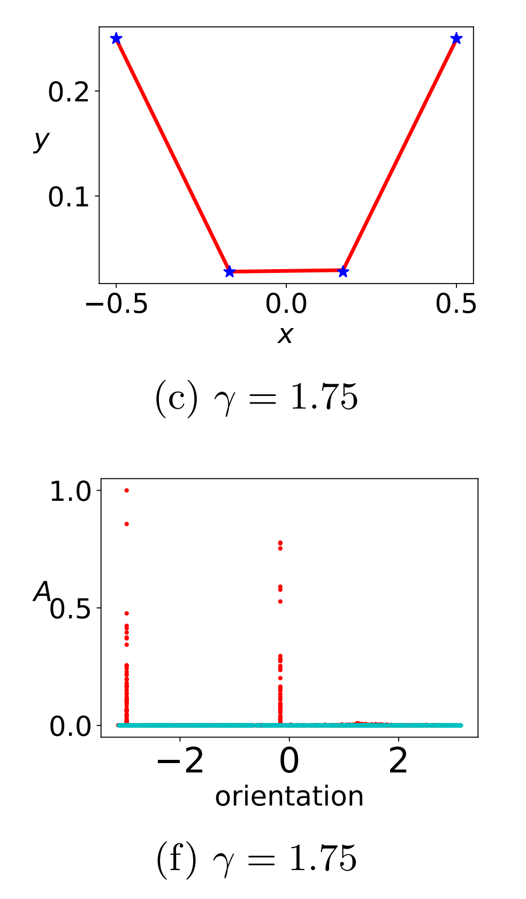
Few effective neurons
Two ReLU neurons are enough!
Tao Luo#, Zhi-Qin John Xu #, Zheng Ma, Yaoyu Zhang*,
Phase diagram for two-layer ReLU neural networks at infinite-width limit, Journal of Machine Learning Research (2021)

Slide 16
Guess: how many samples needed?
Example: Teacher-Student setup
Target: a net of two neurons, 6 parameters
Model: a net of 1000 neurons, 3000 parameters
……
Model
Target

Slide 17
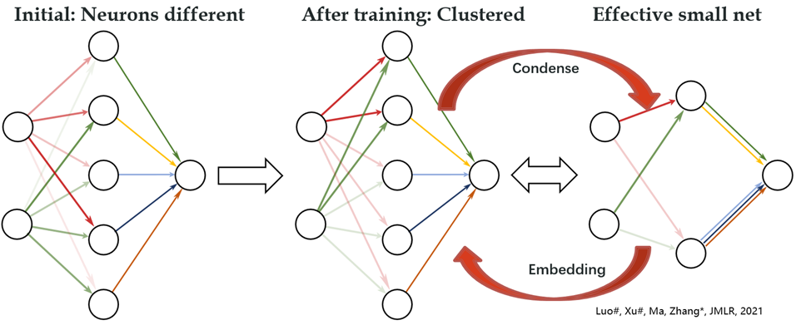

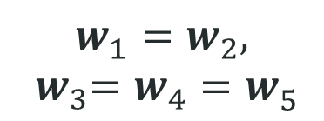
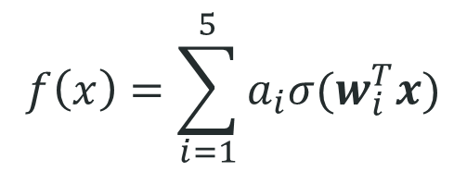
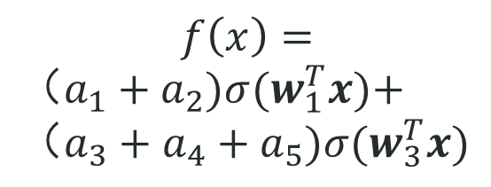
Condensation
$$f\left(x\right)=\sum_{i=1}^{5}{a_{i}σ(w_{i}^{T}x)}$$
$$f\left(x\right)=$$
$（a_{1}+a_{2})σ(w_{1}^{T}x)\text{+}$ $（a_{3}+a_{4}+a_{5})σ(w_{3}^{T}x)$
$$w_{1}^{ }=w_{2}^{ },$$
$${ w}_{3}^{ }=w_{4}^{ }=w_{5}^{ }$$
Initial：random
After training：
Condense
Effective：
Small net

Slide 18
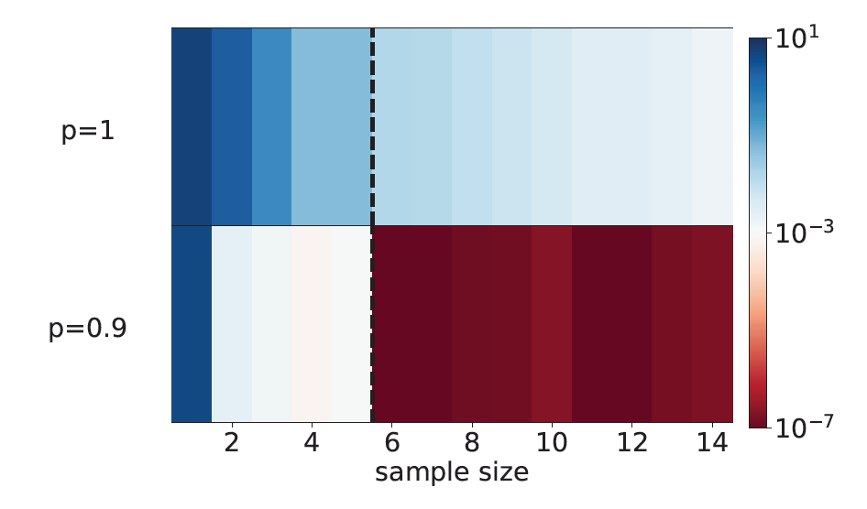
Data size depends on hyper-parameters
Target: a net of two neurons, 6 parameters
Test error
Without condensation
A New Concept!
Optimistic estimation
With condensation
Zhang and Xu*, Implicit regularization of dropout, arxiv: 2207.05952
Zhang*, Zhang, Zhang, Bai, Luo and Xu*, Optimistic Estimate, arxiv: 2307.08921 2207.05952

Slide 19
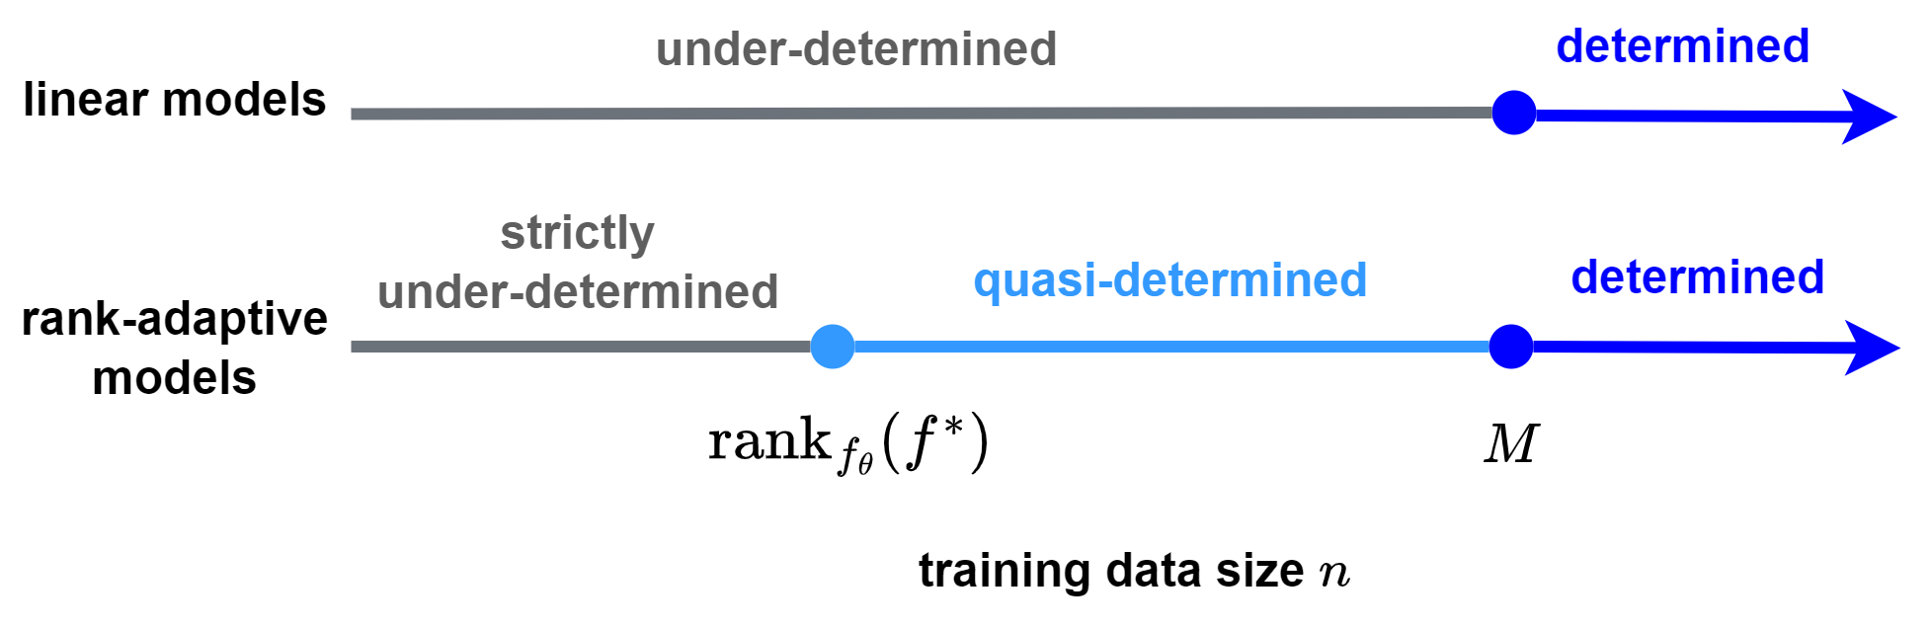
Rethinking: Generalization, sample, parameter
For a model with M parameters, how many samples is needed?
Traditionally, Worst case estimation: M
0
?
M
Optimistic estimation
Example: Teacher-Student setup
Target: a net of two neurons, 6 parameters
Model: a net of 1000 neurons, 3000 parameters
……
Model
Target

Slide 20
全局最小点局部的乐观估计

Slide 21
Condensation → Overparameterization is not an issue!
Tradiationally, data size$≥$para size → generalization good!
How many data are needed for NNs?

Slide 22
If Neural Network is too complex!
Let’s consider a simple case.

Slide 23
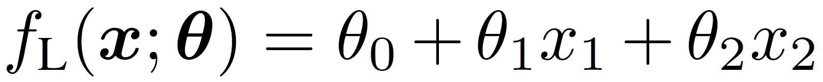
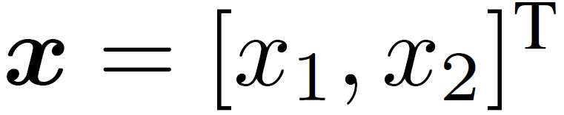
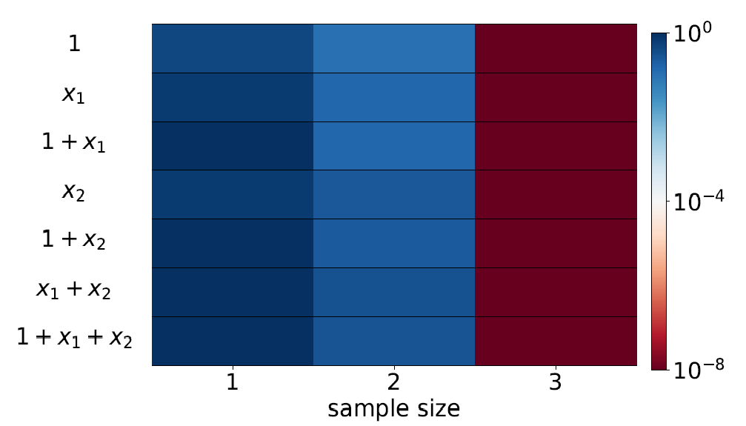
Linear regression
Model
Test error
Target function
Yaoyu Zhang*, Zhongwang Zhang, Leyang Zhang, Zhiwei Bai, Tao Luo, Zhi-Qin John Xu*, Optimistic Estimate Uncovers the Potential of Nonlinear Models, arxiv 2307.08921

Slide 24
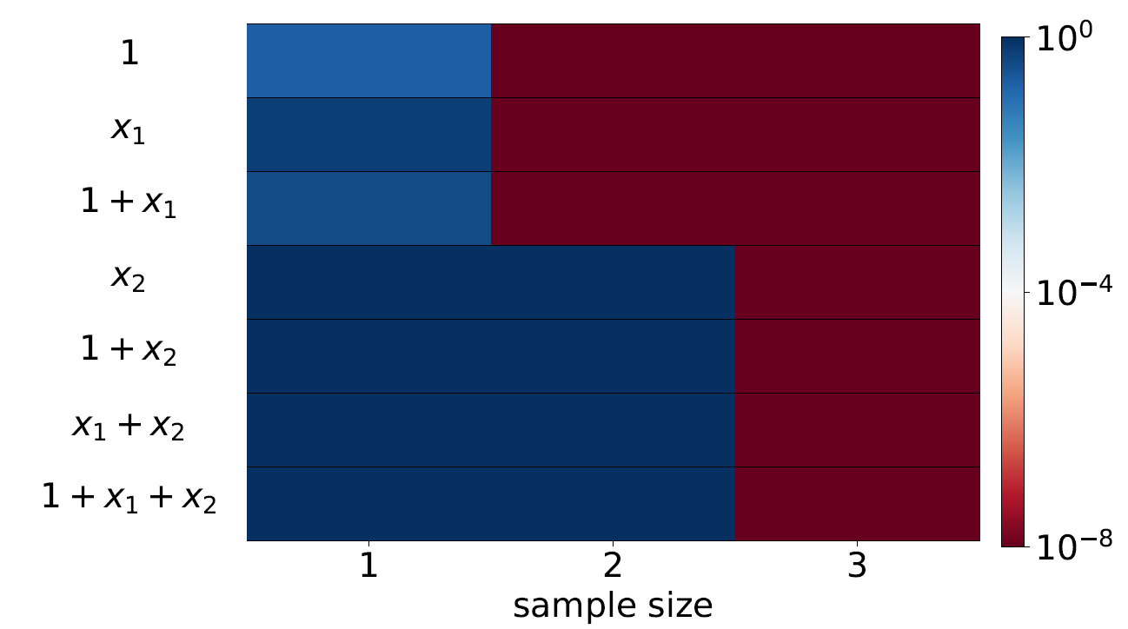
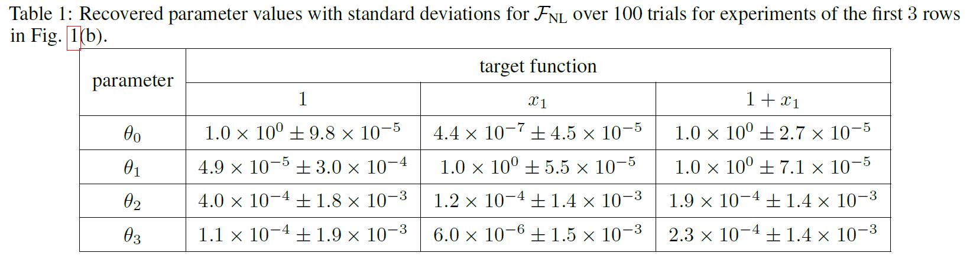
Non-Linear regression
Start with small initialization
Yaoyu Zhang*, Zhongwang Zhang, Leyang Zhang, Zhiwei Bai, Tao Luo, Zhi-Qin John Xu*, Optimistic Estimate Uncovers the Potential of Nonlinear Models, arxiv 2307.08921

Slide 25
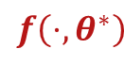
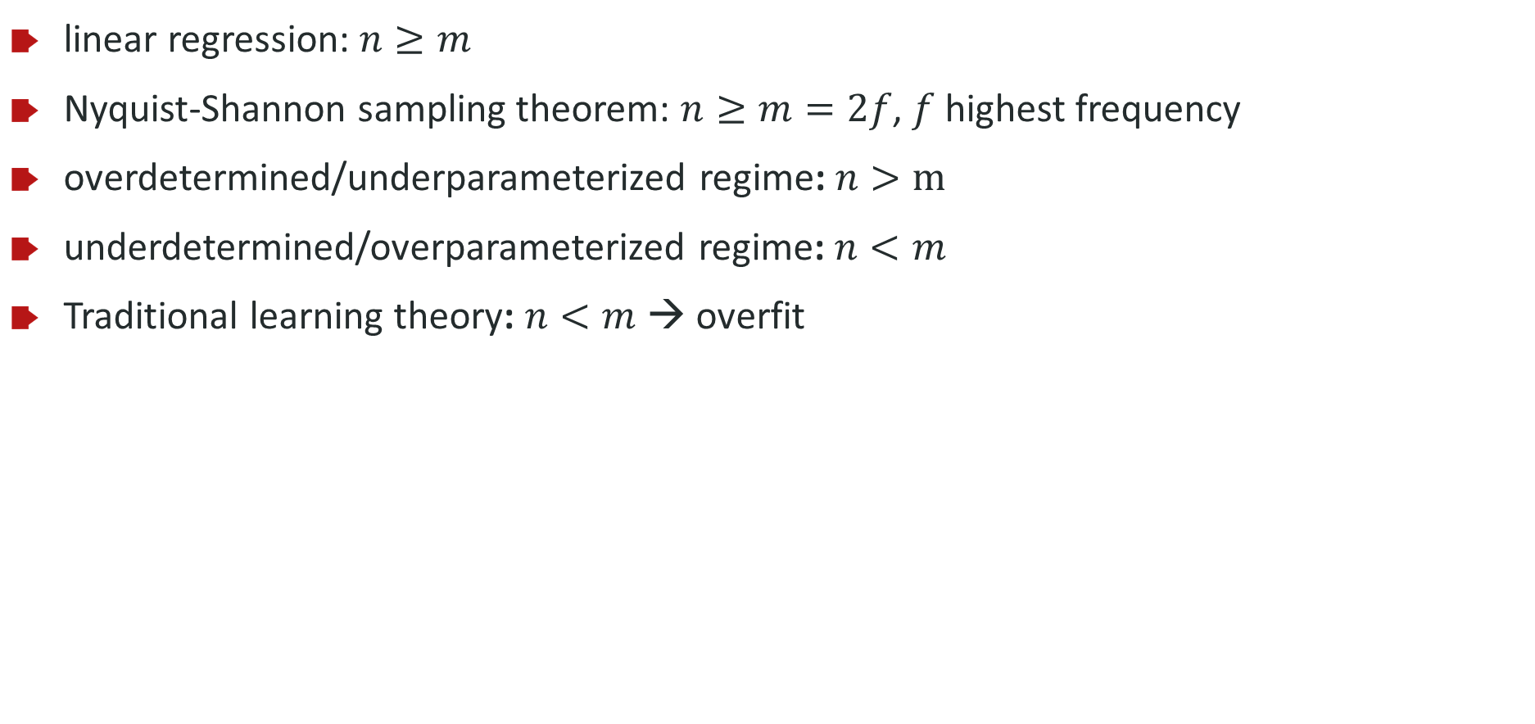
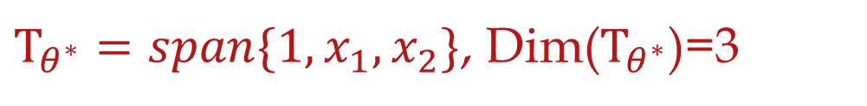
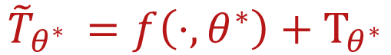
Linear model for recovery
linear regression: $n≥m$
Nyquist-Shannon sampling theorem: $n≥m=2f$, $f$ highest frequency
overdetermined/underparameterized regime: $n>m$
underdetermined/overparameterized regime: $n<m$
Traditional learning theory: $n<m$ → overfit
$${\tilde{T}}_{θ^{∗} }=f\left(⋅,θ^{∗}\right)+Τ_{θ^{∗}}$$
$$f\left(⋅,θ^{∗}\right)$$
$Τ_{θ^{∗}}=span\{1,x_{1},x_{2}\}$, Dim($Τ_{θ^{∗}}$)=3
Yaoyu Zhang*, Zhongwang Zhang, Leyang Zhang, Zhiwei Bai, Tao Luo, Zhi-Qin John Xu*, Optimistic Estimate Uncovers the Potential of Nonlinear Models, arxiv 2307.08921

Slide 26
For a LINEAR model
Data number=parameter number
Yaoyu Zhang*, Zhongwang Zhang, Leyang Zhang, Zhiwei Bai, Tao Luo, Zhi-Qin John Xu*, Optimistic Estimate Uncovers the Potential of Nonlinear Models, arxiv 2307.08921

Slide 27

For a NON-LINEAR model
Data number$≤$parameter number
Yaoyu Zhang*, Zhongwang Zhang, Leyang Zhang, Zhiwei Bai, Tao Luo, Zhi-Qin John Xu*, Optimistic Estimate Uncovers the Potential of Nonlinear Models, arxiv 2307.08921

Slide 28
For a NON-LINEAR model
What is the most optimistic case?
Yaoyu Zhang*, Zhongwang Zhang, Leyang Zhang, Zhiwei Bai, Tao Luo, Zhi-Qin John Xu*, Optimistic Estimate Uncovers the Potential of Nonlinear Models, arxiv 2307.08921

Slide 29
For a NON-LINEAR model
What is the most optimistic case?
Initialize very close to global minina!
$$f\left(⋅;θ \right)≈f^{lin}\left(⋅;θ \right)=f^{∗}\left(⋅\right)+∇_{θ}f\left(⋅;θ^{′}\right)(θ−θ′)$$
Yaoyu Zhang*, Zhongwang Zhang, Leyang Zhang, Zhiwei Bai, Tao Luo, Zhi-Qin John Xu*, Optimistic Estimate Uncovers the Potential of Nonlinear Models, arxiv 2307.08921

Slide 30
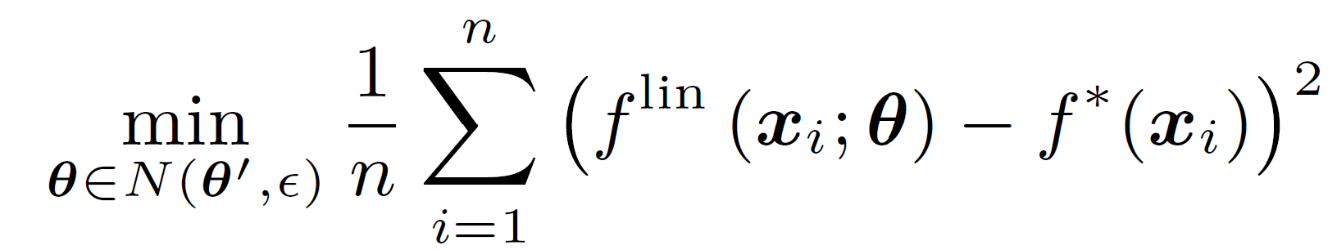
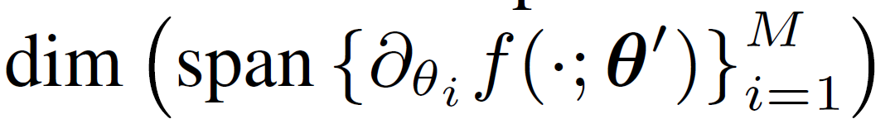
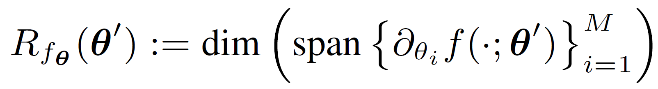
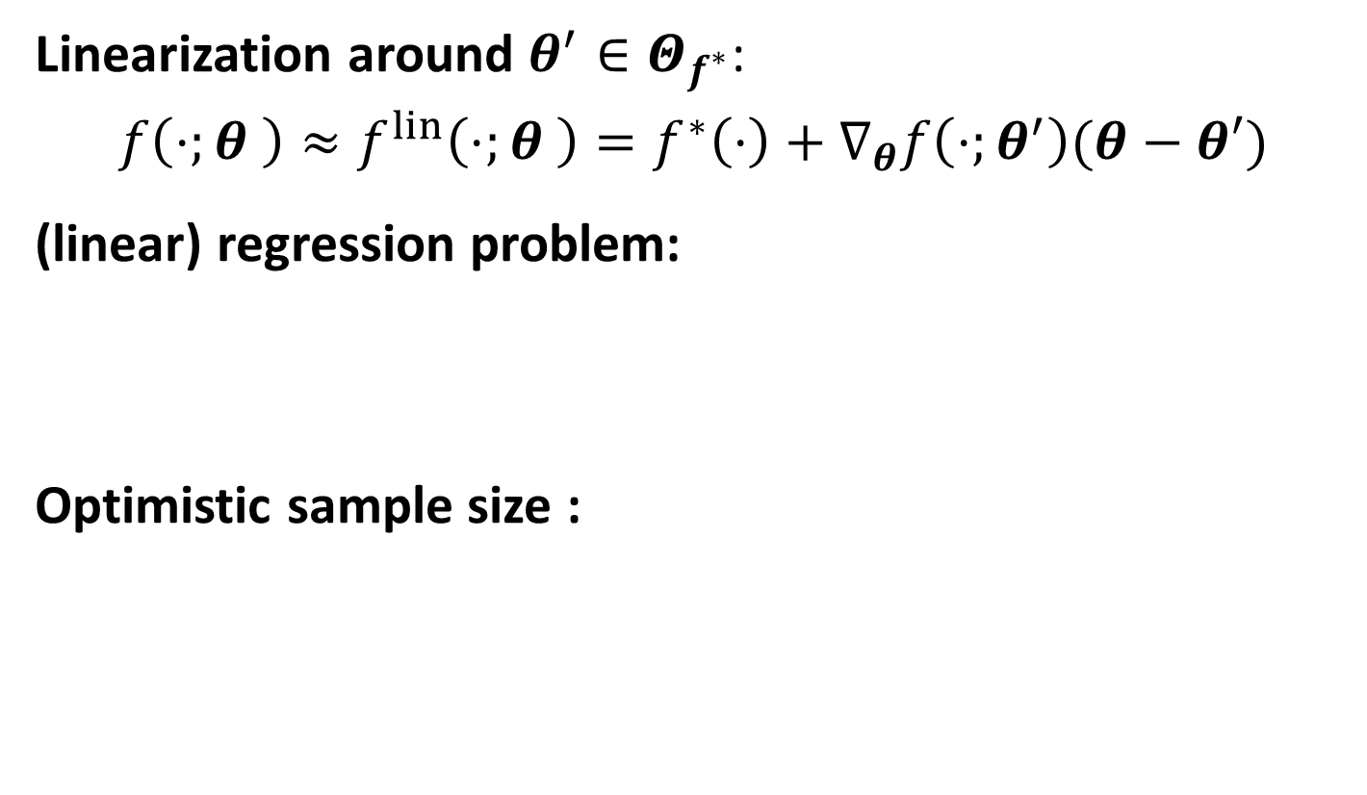

Sample size estimate through linearization
Linearization around $θ^{′}∈Θ_{f^{∗}}$:
$$f\left(⋅;θ \right)≈f^{lin}\left(⋅;θ \right)=f^{∗}\left(⋅\right)+∇_{θ}f\left(⋅;θ^{′}\right)(θ−θ′)$$
(linear) regression problem:
Optimistic sample size :
In Condensed Case:
DIM is very small!
Model rank at $θ′$：
Yaoyu Zhang*, Zhongwang Zhang, Leyang Zhang, Zhiwei Bai, Tao Luo, Zhi-Qin John Xu*, Optimistic Estimate Uncovers the Potential of Nonlinear Models, arxiv 2307.08921

Slide 31
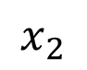
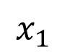
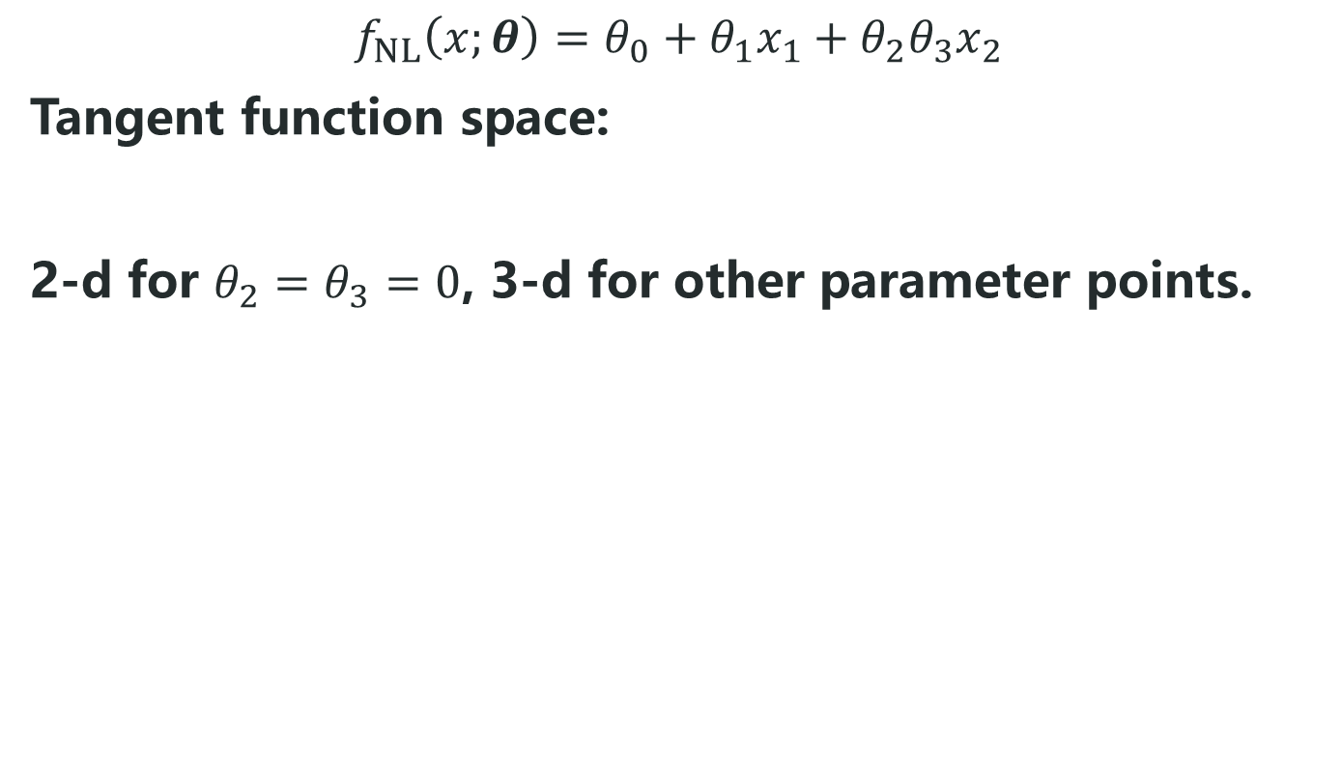
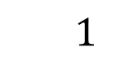
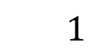
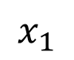
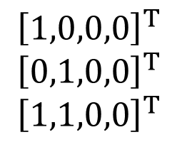
Local effective degrees of freedom
$$f_{NL}\left(x;θ\right)=θ_{0}+θ_{1}x_{1}+θ_{2}θ_{3}x_{2}$$
Tangent function space:
2-d for $θ_{2}=θ_{3}=0$, 3-d for other parameter points.
linearly stable with 2 samples
$$x_{1}$$
$$x_{1}$$
linearly stable with 3 samples
$$1$$
$${\left[1,0,0,0\right]}^{T}$$
$${\left[0,1,0,0\right]}^{T}$$
$${\left[1,1,0,0\right]}^{T}$$
$$1$$
$$x_{2}$$
Yaoyu Zhang*, Zhongwang Zhang, Leyang Zhang, Zhiwei Bai, Tao Luo, Zhi-Qin John Xu*, Optimistic Estimate Uncovers the Potential of Nonlinear Models, arxiv 2307.08921

Slide 32
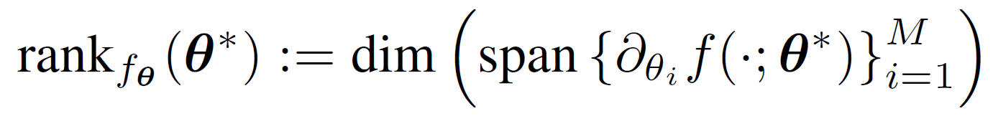
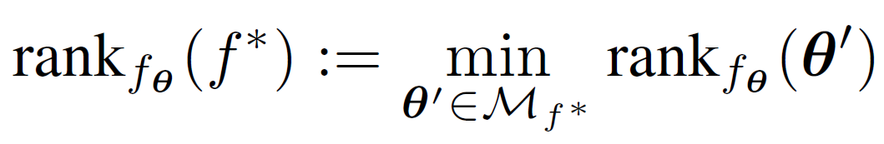
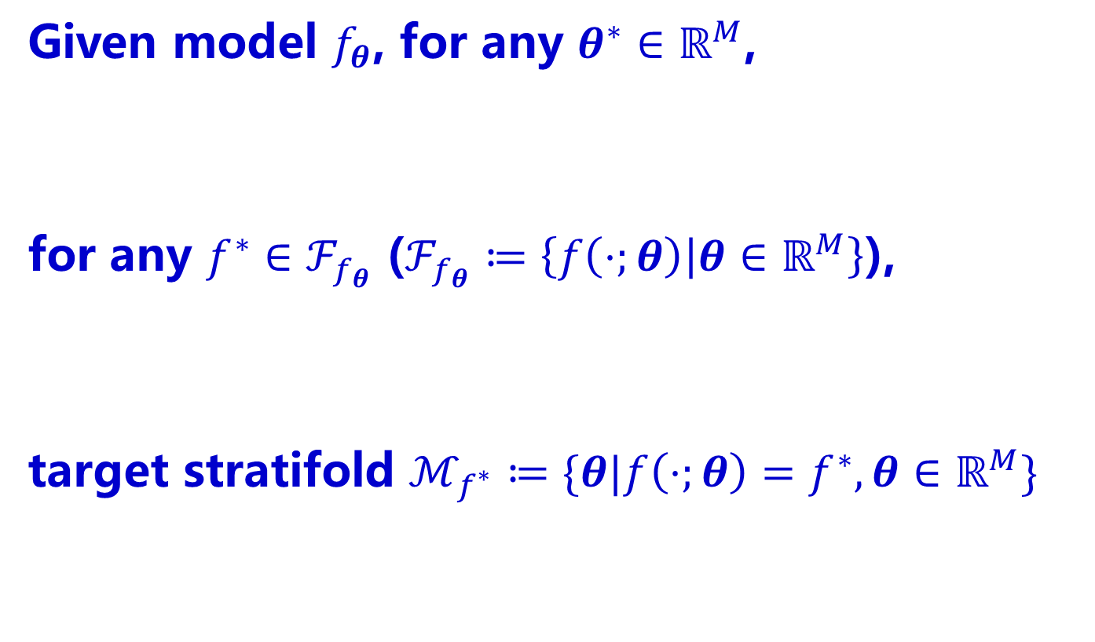
Model rank as “effective size of parameters”
Given model $f_{θ}$, for any $θ^{∗}∈ℝ^{M}$,
for any $f^{∗}∈ℱ_{f_{θ}}$ ($ℱ_{f_{θ}}≔\left\{f\left(⋅;θ\right) | θ∈ℝ^{M}\right\}$),
target stratifold $ℳ_{f^{∗}}≔\{θ|f\left(⋅;θ\right)=f^{∗},θ∈ℝ^{M}\}$
Yaoyu Zhang*, Zhongwang Zhang, Leyang Zhang, Zhiwei Bai, Tao Luo, Zhi-Qin John Xu*, Optimistic Estimate Uncovers the Potential of Nonlinear Models, arxiv 2307.08921

Slide 33
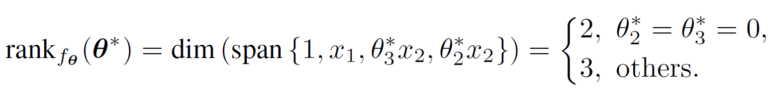
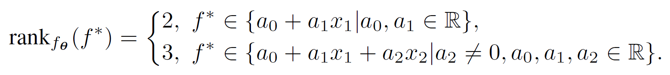
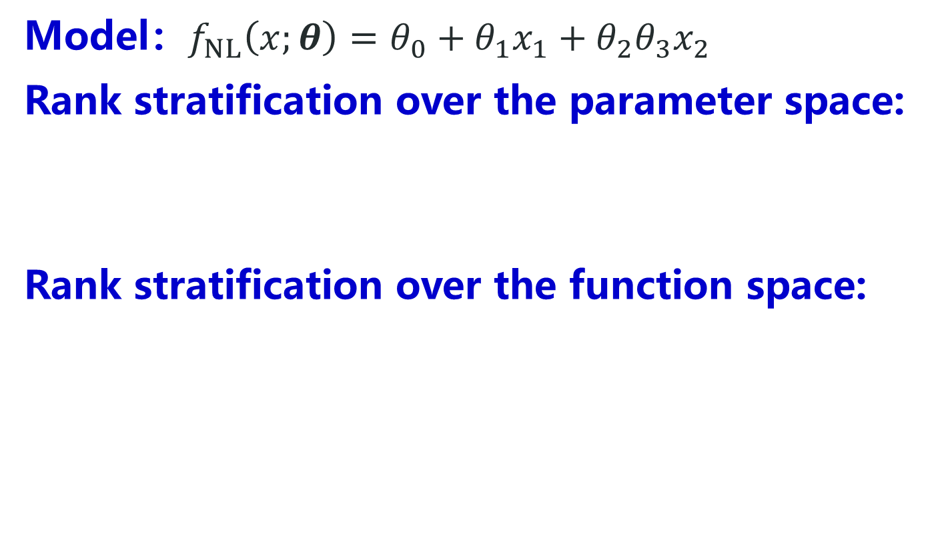
Rank depends on parameter for non-linear model
Model：$f_{NL}\left(x;θ\right)=θ_{0}+θ_{1}x_{1}+θ_{2}θ_{3}x_{2}$
Rank stratification over the parameter space:
Rank stratification over the function space:
VS. $f_{L}\left(x;θ\right)=θ_{0}+θ_{1}x_{1}+θ_{2}x_{2}$ ：constant rank-3
Yaoyu Zhang*, Zhongwang Zhang, Leyang Zhang, Zhiwei Bai, Tao Luo, Zhi-Qin John Xu*, Optimistic Estimate Uncovers the Potential of Nonlinear Models, arxiv 2307.08921

Slide 34
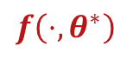
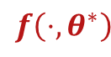
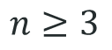
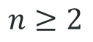
Linear stability in local recovery
When data size>dim (Tangent space), linearly stable for local optimization.
$$f\left(⋅,θ^{∗}\right)$$
$$f\left(⋅,θ^{∗}\right)$$
$$n≥2$$
$$n≥3$$
Linear stability hypothesis:
Non-linear trainings prefer linear stable point
Yaoyu Zhang*, Zhongwang Zhang, Leyang Zhang, Zhiwei Bai, Tao Luo, Zhi-Qin John Xu*, Optimistic Estimate Uncovers the Potential of Nonlinear Models, arxiv 2307.08921

Slide 35
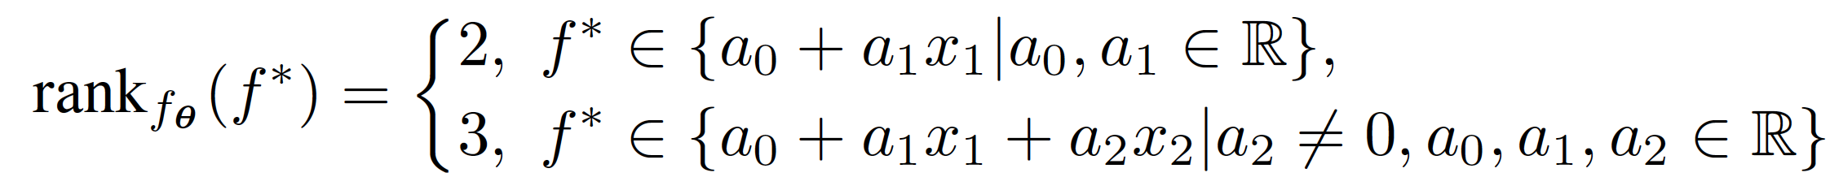
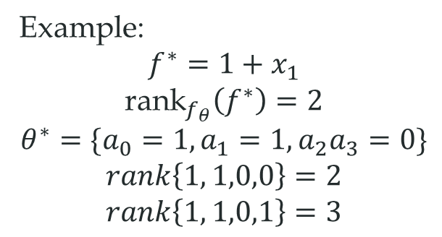
Linear stability hypothesis: prefer linear stable point
Linearly stable global minimizers are more likely to be selected by a nonlinear training process.
Example:
$$f^{∗}=1+x_{1}$$
$${\text{rank}}_{f_{θ}}\left(f^{∗}\right)=2$$
$$θ^{∗}=\{a_{0}=1,a_{1}=1,a_{2}a_{3}=0\}$$
$$rank\left\{1, 1,0,0\right\}=2$$
$$rank\left\{1, 1,0,1\right\}=3$$
Yaoyu Zhang*, Zhongwang Zhang, Leyang Zhang, Zhiwei Bai, Tao Luo, Zhi-Qin John Xu*, Optimistic Estimate Uncovers the Potential of Nonlinear Models, arxiv 2307.08921

Slide 36


Rank stratification for matrix factorization
Model：$f_{θ}=AB$, $θ=\left(A,B\right),A,B∈ℝ^{d×d}$
Rank stratification over the parameter space:
$$d^{2}−(d−r_{A})(d−r_{B})$$
Rank stratification over the function space:
Yaoyu Zhang*, Zhongwang Zhang, Leyang Zhang, Zhiwei Bai, Tao Luo, Zhi-Qin John Xu*, Optimistic Estimate Uncovers the Potential of Nonlinear Models, arxiv 2307.08921

Slide 37


Demonstration of linear stability hypothesis
$4×4$ matrix completion
Yaoyu Zhang*, Zhongwang Zhang, Leyang Zhang, Zhiwei Bai, Tao Luo, Zhi-Qin John Xu*, Optimistic Estimate Uncovers the Potential of Nonlinear Models, arxiv 2307.08921

Slide 38


A new regime: Quasi-determined regime
Over-determined regime: data size > para size
Under-determined regime: data size < para size
For non-linear models:
Quasi-determined regime: ${\text{rank}}_{f_{θ}}\left(f^{∗}\right)$<data size<para size
Yaoyu Zhang*, Zhongwang Zhang, Leyang Zhang, Zhiwei Bai, Tao Luo, Zhi-Qin John Xu*, Optimistic Estimate Uncovers the Potential of Nonlinear Models, arxiv 2307.08921

Slide 39

Feature of the quasi-determined regime
Success of recovery depends on initialization;
Increasing data size beyond model rank enhances tolerance on data size.
Yaoyu Zhang*, Zhongwang Zhang, Leyang Zhang, Zhiwei Bai, Tao Luo, Zhi-Qin John Xu*, Optimistic Estimate Uncovers the Potential of Nonlinear Models, arxiv 2307.08921

Slide 40
神经网络的乐观估计
Yaoyu Zhang*, Zhongwang Zhang, Leyang Zhang, Zhiwei Bai, Tao Luo, Zhi-Qin John Xu*, Optimistic Estimate Uncovers the Potential of Nonlinear Models, arxiv 2307.08921

Slide 41


Optimistic sample size for $f^{∗}$
The “optimal” point $θ^{∗}$ in $Θ_{f^{∗}}$:
$$θ^{∗}=\underset{θ^{′}∈Θ_{f^{∗}}}{argmin}{R_{f_{θ}}\left(θ^{′}\right)}$$
The optimistic sample size for $f^{∗}$:
$$R_{f_{θ}}\left(f^{∗}\right)≔R_{f_{θ}}\left(θ^{∗}\right)=\min_{θ^{′}∈Θ_{f^{∗}}}{R_{f_{θ}}\left(θ^{′}\right)}$$
……
Model
Target
Optimistic CASE: 6 samples
0
$R_{f_{θ}} (f^{∗} )$
M
Yaoyu Zhang*, Zhongwang Zhang, Leyang Zhang, Zhiwei Bai, Tao Luo, Zhi-Qin John Xu*, Optimistic Estimate Uncovers the Potential of Nonlinear Models, arxiv 2307.08921

Slide 42

Rank stratification for fully-connected NNs
Rank independent of width, free expressiveness property.
Yaoyu Zhang*, Zhongwang Zhang, Leyang Zhang, Zhiwei Bai, Tao Luo, Zhi-Qin John Xu*, Optimistic Estimate Uncovers the Potential of Nonlinear Models, arxiv 2307.08921

Slide 43

Condensed neurons has same tangent space
Initial: Neurons different
After training: Clustered
Effective small net
Condense
Embedding
Luo#, Xu#, Ma, Zhang*, JMLR, 2021

Slide 44


Which is the better way to increase complexity?
$f^{∗}=$
vs.
vs.
12
24
24
Yaoyu Zhang*, Zhongwang Zhang, Leyang Zhang, Zhiwei Bai, Tao Luo, Zhi-Qin John Xu*, Optimistic Estimate Uncovers the Potential of Nonlinear Models, arxiv 2307.08921

Slide 45
Which is the better way to increase complexity?
costly expressiveness
costly expressiveness
Each connection increases local dim
24
vs.
24
vs.
12
Condensation
Neuron does not
increases local dim
12
free expressiveness
free expressiveness
24
24
Yaoyu Zhang*, Zhongwang Zhang, Leyang Zhang, Zhiwei Bai, Tao Luo, Zhi-Qin John Xu*, Optimistic Estimate Uncovers the Potential of Nonlinear Models, arxiv 2307.08921

Slide 46



Target function
Model：
DNN
CNN without weight sharing
CNN with weight sharing
Yaoyu Zhang*, Zhongwang Zhang, Leyang Zhang, Zhiwei Bai, Tao Luo, Zhi-Qin John Xu*, Optimistic Estimate Uncovers the Potential of Nonlinear Models, arxiv 2307.08921

Slide 47

不同网络结构

Slide 48

CNN needs more data than FNN
Yaoyu Zhang*, Zhongwang Zhang, Leyang Zhang, Zhiwei Bai, Tao Luo, Zhi-Qin John Xu*, Optimistic Estimate Uncovers the Potential of Nonlinear Models, arxiv 2307.08921

Slide 49

Attempt to answer important problems
Models capable of fitting at overparameterization: nonlinear models with non-constant optimistic sample sizes.
Effective size of parameters of a nonlinear model $f_{θ}$: $R_{f_{θ}}(f^{∗})$ for $f^{∗}∈ℱ$.
Implicit bias of a nonlinear model: towards an interpolation with a lower optimistic sample size.
Advantage of NN models: free expressiveness in width.
Superiority of the local connection in CNNs: costly expressiveness in connection.
Yaoyu Zhang*, Zhongwang Zhang, Leyang Zhang, Zhiwei Bai, Tao Luo, Zhi-Qin John Xu*, Optimistic Estimate Uncovers the Potential of Nonlinear Models, arxiv 2307.08921

Slide 50
小结
最差估计：传统复杂度分析
凝聚神经网络所需样本<<最差估计
乐观估计：在全局最小点附近
调参可以逼近乐观估计
凝聚现象可以增加表达能力，但不使乐观估计的样本数增加

